Slide 1
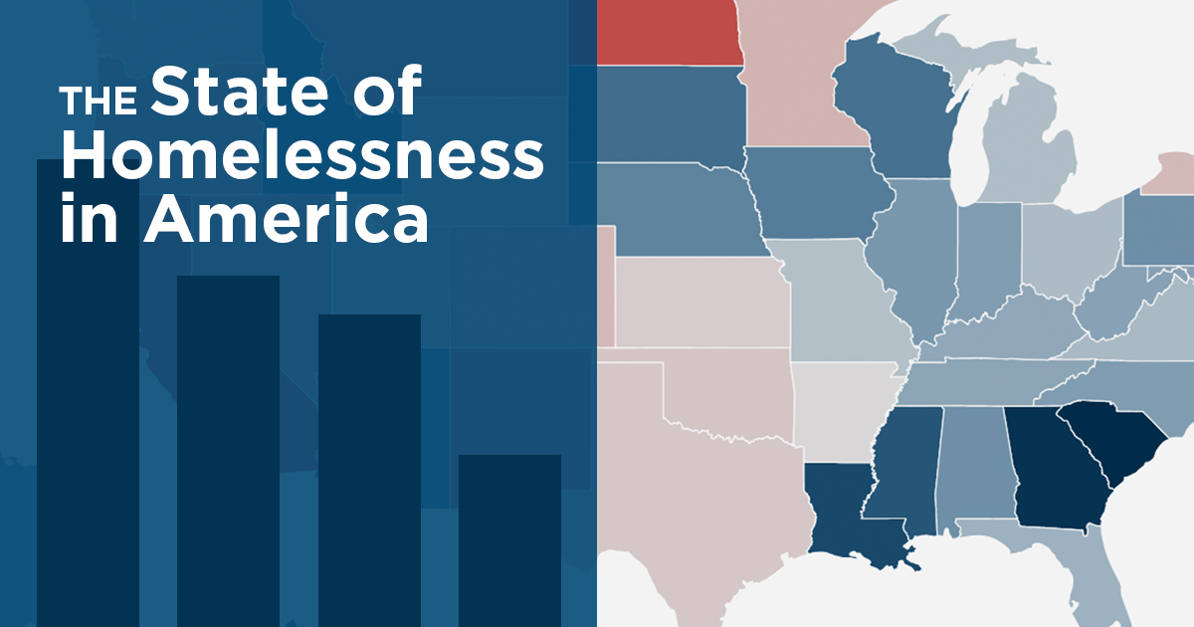

Slide 2
Introduction
Good morning ladies and gentlemen, I stand here to advocate for the need to understand homelessness a major problem in our society that has affected almost every individual ranging from street people to those who might have experienced violence and chased away.
It pushes me so hard to emphatically say without fear of contraction that for fact homelessness proves a major issue of concern this is because Homeless people are over nine times more likely to take their own life than the general population homeless.

Slide 3
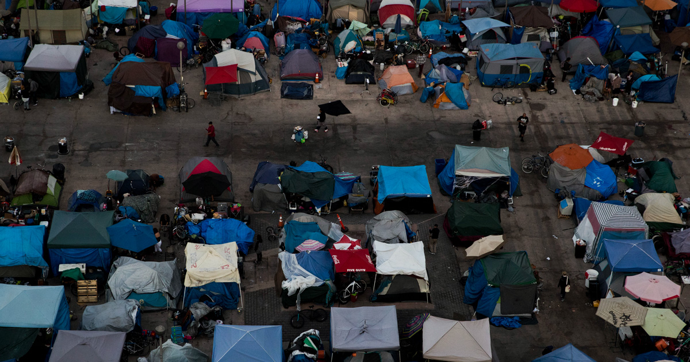
The Effects of Homelessness

Slide 4
The Effects of Homelessness
Living on the street makes homeless people more vulnerable to abuse.
Tears families apart.
Being without a home takes a terrible toll on children.
Homeless adults are also at greater risk for serious health conditions.

Slide 5
ways in which you can help the homeless
Volunteer
Donate
Advocate
Employ
Respect

Slide 6
Conclusion
The fundamental problem encountered by homeless people such as lack of a stable residence have a direct and deleterious impact on health.
Not only does homelessness cause health problems, but it also perpetuates and exacerbates poor health by seriously impeding efforts to treat disease and reduce disability thus need for great consideration on the issue of homelessness (Hutson, 1994).

Slide 7
References
Hill, R. P. (1994). The public policy issue of homelessness: A review and synthesis of existing research. Journal of Business Research, 30(1), 5-12.
Hutson, S. (1994). Youth homelessness: The construction of a social issue. Macmillan International Higher Education.
Lehman, A. F., Kernan, E., DeForge, B. R., & Dixon, L. (1995). Effects of homelessness on the quality of life of persons with severe mental illness. Psychiatric Services.

